Slide 1
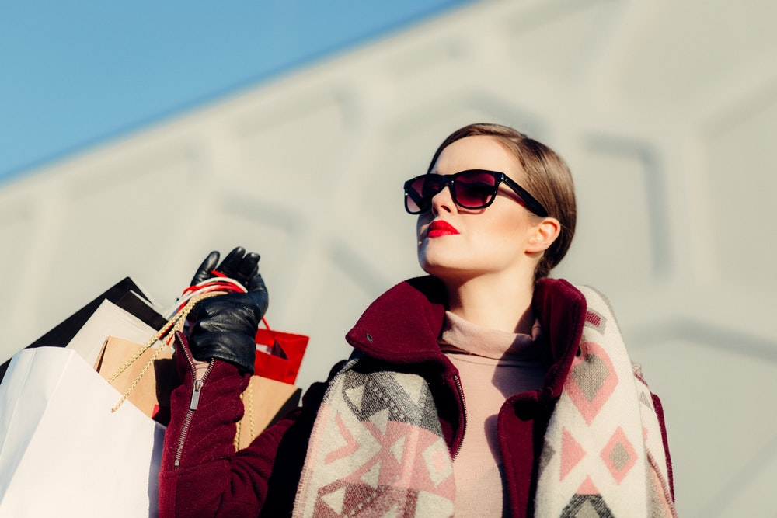
Hip-Drobe
힙드로브, 내 손 안의 옷장
Designed by. Passion Leader
윤루빈 | 김재현 | 김현민 | 성하진

Slide 2
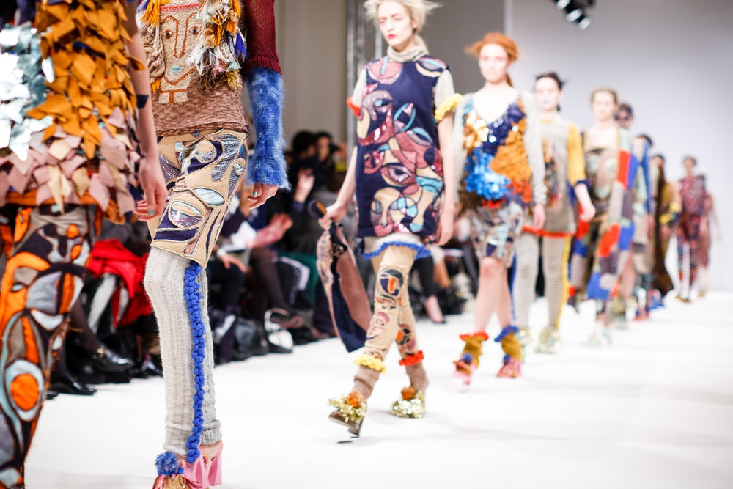
기획 의도 (문제

Slide 3
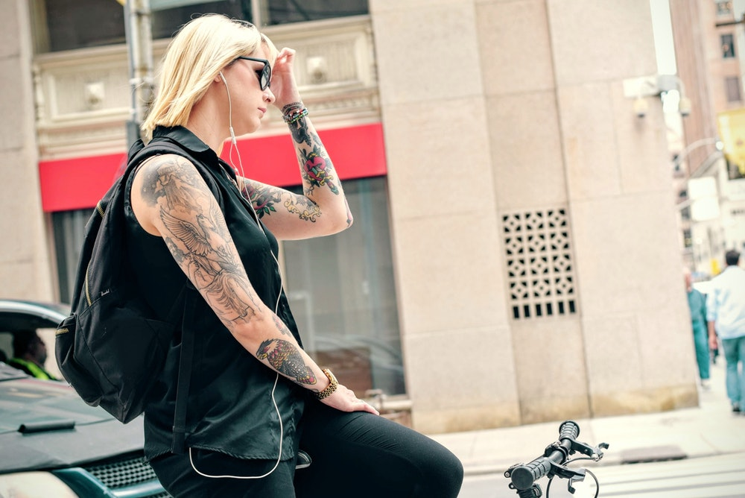
01 YOUR FASHION STYLE

Slide 4
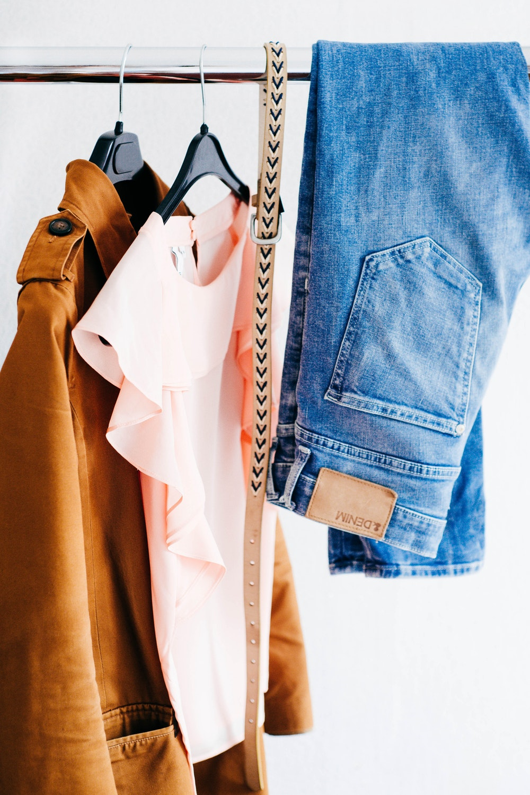
FINE MY FASHION STYLE
Made by Hanarin

Slide 5
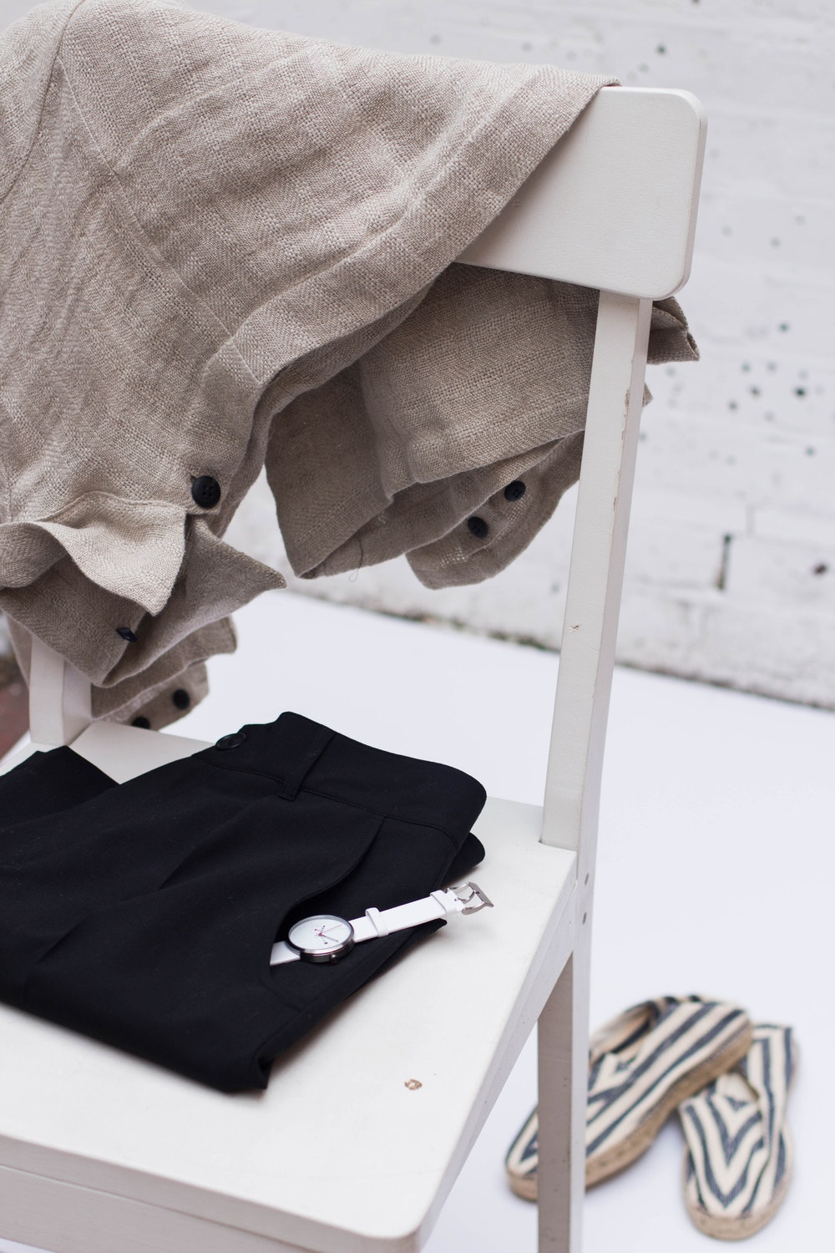
FIND MY FASHION STYLE
Made by Hanarin
Fashion is a popular style or practice, especially in clothing, footwear, accessories, makeup, hairstyle and body. Fashion is a distinctive and often constant trend in the style in which a person dresses. It is the prevailing styles in behaviour and the newest creations of textile designers. Because the more technical term costume is regularly linked to the term "fashion", the use of the former has been relegated to special senses like fancy dress or masquerade wear, while "fashion" generally means clothing, including the study of it. Although aspects of fashion can be feminine or masculine, some trends are androgynous.

Slide 6
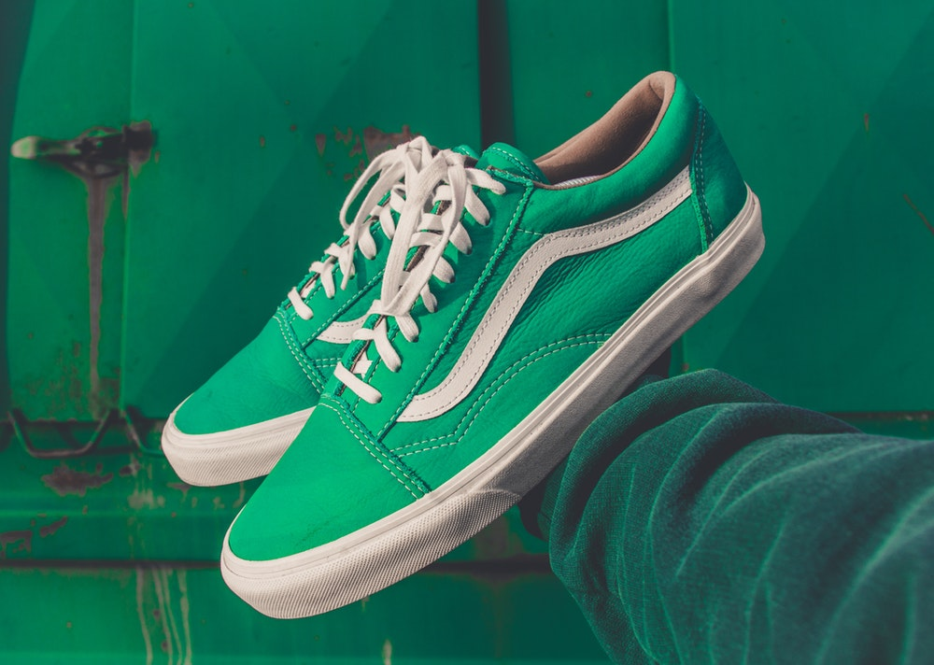
02 FIND YOUR PERSONAL COLOR

Slide 7
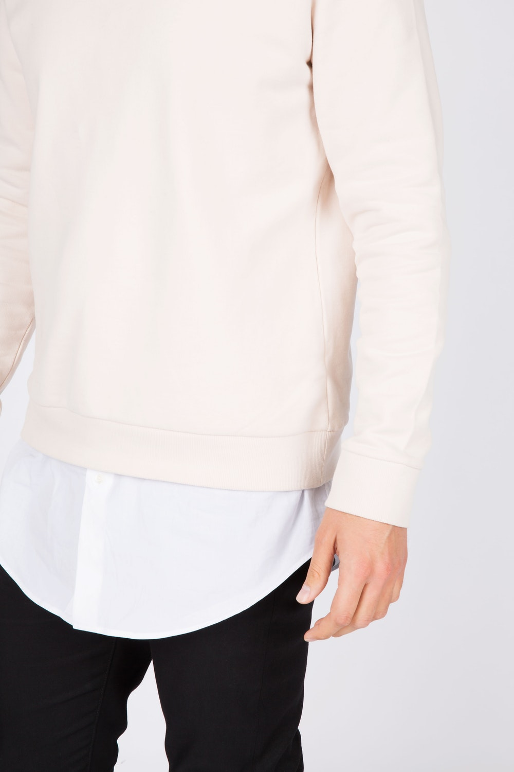
FIND MY FASHION STYLE
Made by Hanarin
Fashion is a popular style or practice, especially in clothing, footwear, accessories, makeup, hairstyle and body. Fashion is a distinctive and often constant trend in the style in which a person dresses.
It is the prevailing styles in behaviour and the newest creations of textile designers. Because the more technical term costume is regularly linked to the term "fashion",
The use of the former has been relegated to special senses like fancy dress or masquerade wear, while "fashion" generally means clothing, including the study of it. Although aspects of fashion can be feminine or masculine, some trends are androgynous.

Slide 8
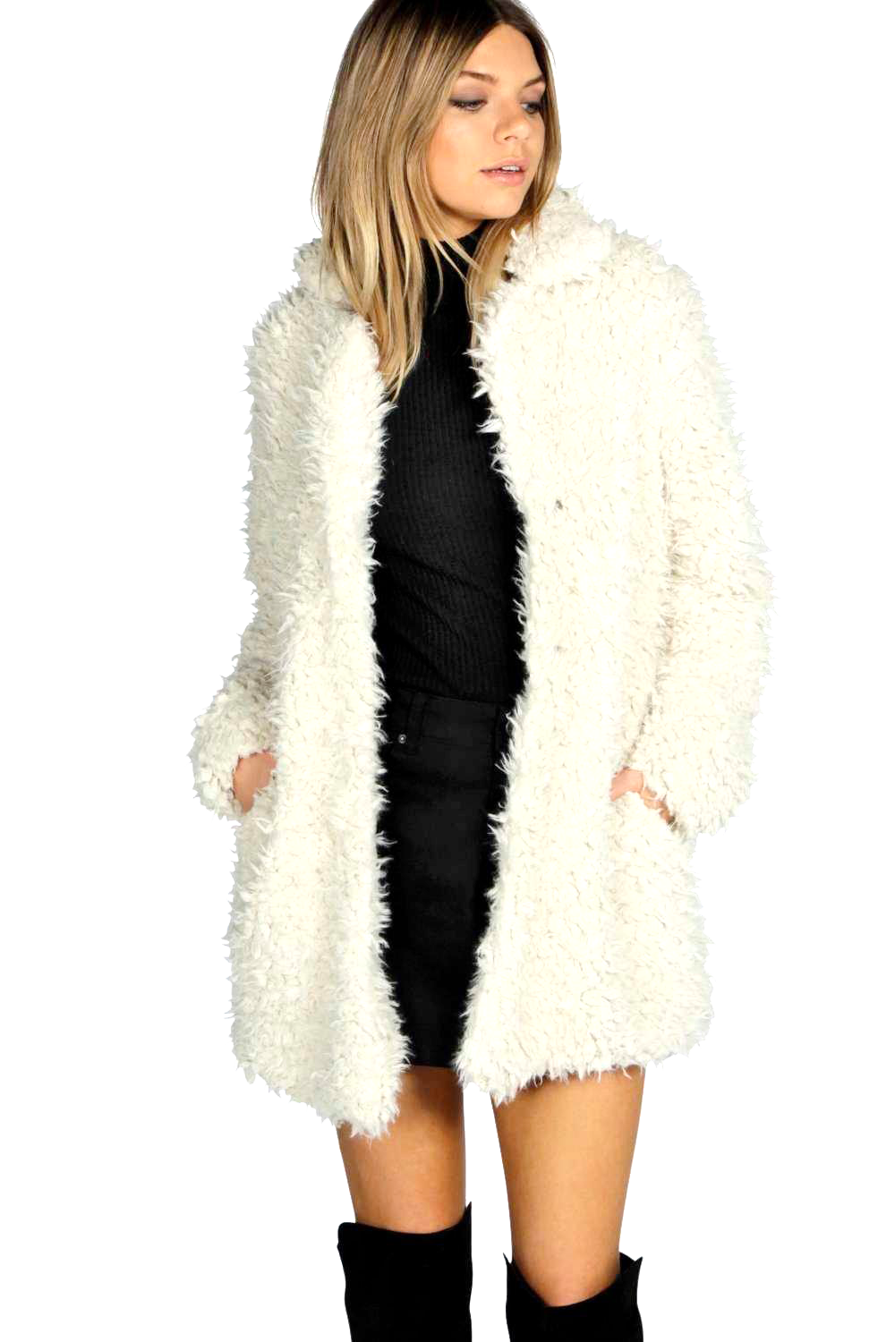
New White fur coat
2018 Spring season new white fur coat made by Transfashion.
FIND
MY FASHION
STYLE
Black comfortable
Fashion is a popular style or practice, especially in clothing, footwear, accessories, makeup, hairstyle and body. Fashion is a distinctive and often constant trend in the style in which a person dresses. It is the prevailing styles in behaviour and the newest creations of textile designers
2017 Black comfortable dress.
Fashion style
Who like style like this woman?

Slide 9
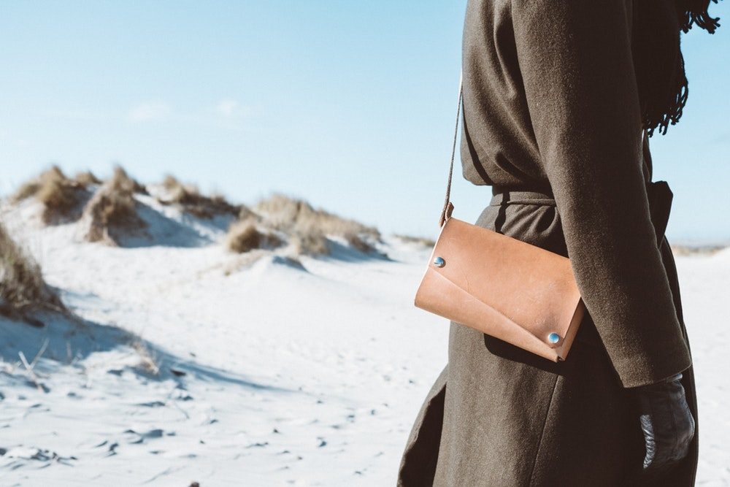
03 MAKE YOUR DAY

Slide 10
03 MAKE YOUR DAY

Slide 11
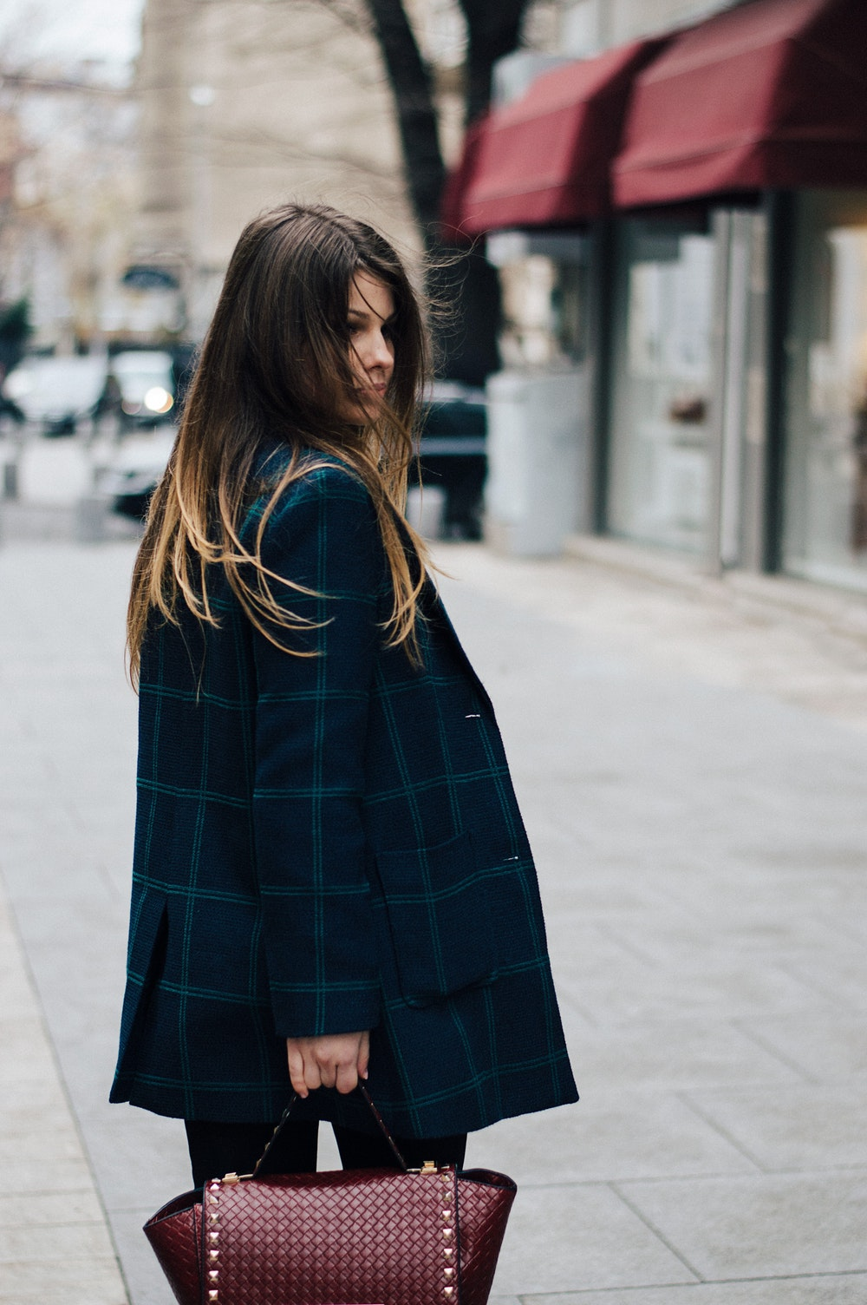
FIND MY FASHION STYLE
Made by Hanarin
Fashion is a popular style or practice, especially in clothing, footwear, accessories, makeup, hairstyle and body. Fashion is a distinctive and often constant trend in the style in which a person dresses. It is the prevailing styles in behaviour and the newest creations of textile designers. Because the more technical term costume is regularly linked to the term "fashion", the use of the former has been relegated to special senses like fancy dress or masquerade wear, while "fashion" generally means clothing, including the study of it. Although aspects of fashion can be feminine or masculine, some trends are androgynous.

Slide 12
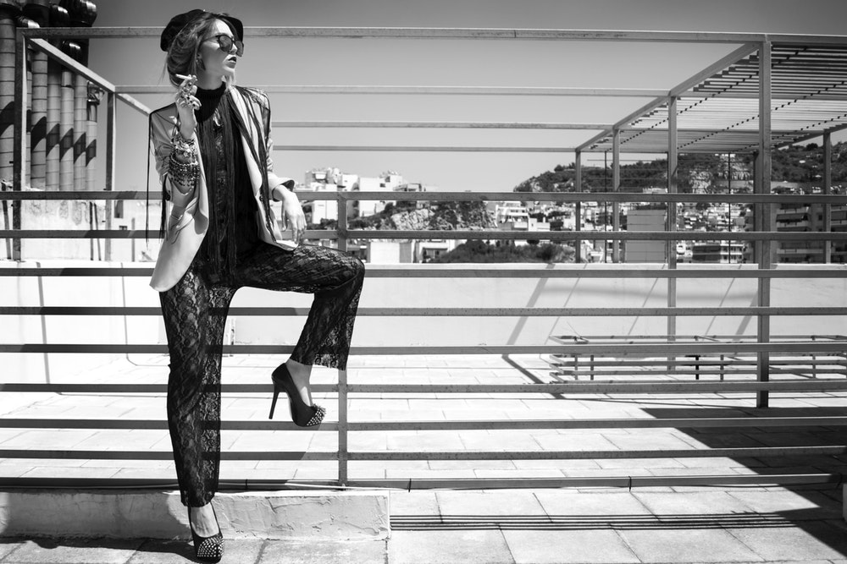
FREE PAGE FOR YOU

Slide 13
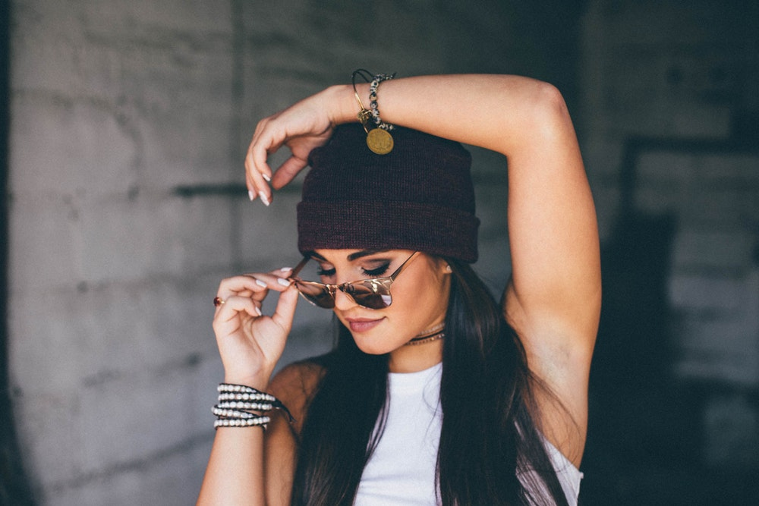
THANK YOU FOR WATCHING!
Made by Hanarin

